Slide 1
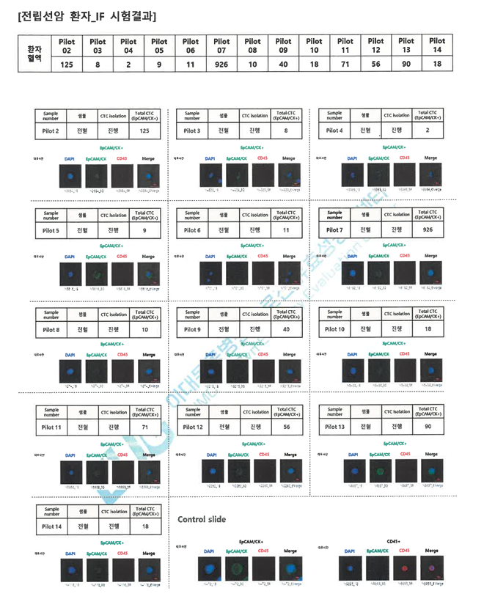
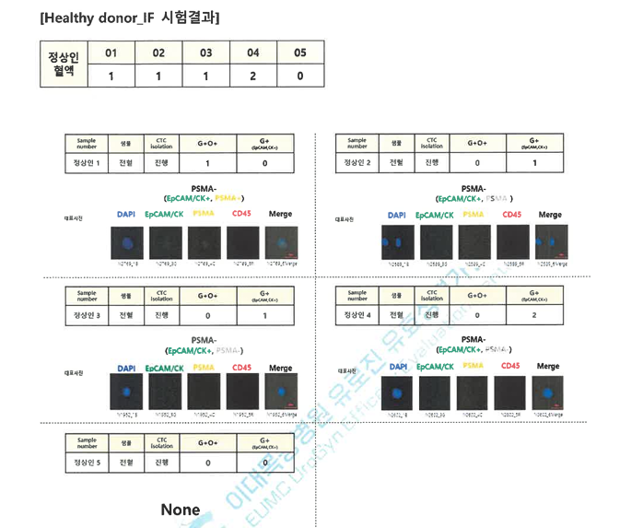
Appendix
IF Results
EpCAM/CK+ | Healthy donor (n=5) |  |  |  |  | Patients (n=12)
 | #01 | #02 | #03 | #04 | #05 | #01 | #02 | #03 | #04 | #05 | #06 | #07 | #08 | #09 | #10 | #11 | #12
No. of CTC | 1 | 1 | 1 | 2 | 0 | 125 | 8 | 9 | 11 | 926 | 10 | 40 | 18 | 71 | 56 | 90 | 18

Slide 2
Appendix
ddPCR results
ddPCR
 |  | Healthy donor |  |  |  |  |  | Patient
number of progress | NTC | 22RV1 | #01 | #02 | #03 | #04 | #05 | #01 | #02 | #03 | #04 | #05 | #06 | #07 | #08 | #09 | #10 | #11 | #12
1 | 0 | 430 | 0 | 2 | 0 | 2 | 0 | 2 | 0 | 2 | 13 | 5 | 0 | 0 | 0 | 1 | 28 | 5 | 8
2 | 0 | 484 | 1 | 0 | 1 | 2 | 0 | 2 | 0 | 1 | 8 | 1 | 0 | 1 | 0 | 2 | 22 | 7 | 14

Slide 3
Appendix
Clinical Data and Laboratory Data
 | ARI effect | PSA | 6mo PSA | FU period from meta (mo) | CTC_No | CTC10 | ddPCR1 | ddPCR2 | ddpcr_avg
pilot 1 | 0 | 170.00 | 156.00 | 144.00 | 125 | 1 | 2 | 2 | 2
pilot 2 | 1 | 1460.00 | 1.18 | 6.00 | 8 | 0 | 0 | 0 | 0
pilot 3 | 1 | 451.44 | 0.01 | 6.00 | 9 | 0 | 2 | 1 | 1.5
pilot 4 | 0 | 900.00 | x | 22.00 | 11 | 1 | 14 | 8 | 11
pilot 5 | 0 | 74.70 | 299.00 | 12.00 | 926 | 1 | 4 | 1 | 2.5
pilot 6 | 0 | 161.00 | 653.00 | 30.00 | 10 | 1 | 0 | 0 | 0
pilot 7 | 0 | 20.30 | 21.40 | 32.00 | 40 | 1 | 0 | 1 | 0.5
pilot 8 | 0 | 0.69 | 2.97 | 51.00 | 18 | 1 | 0 | 0 | 0
pilot 9 | 0 | 587.00 | x | 39.00 | 71 | 1 | 1 | 2 | 1.5
pilot 10 | 0 | 400.00 | 68.00 | 22.00 | 58 | 1 | 26 | 22 | 24
pilot 11 | 1 | 742.00 | 0.64 | 3.00 | 90 | 1 | 5 | 7 | 6
pilot 12 | 0 | 95.70 | 226.00 | 32.00 | 18 | 1 | 8 | 14 | 11

